Slide 1

LLM PER SO ESPERIMENTO 1.0 (Risultati finali ES.5)
Tesi di laurea magistrale in Software Security
Andrea Esposito, M63001650
(22/04/2026)

Slide 2
Modifiche effettuate
Analisi statica eseguita esclusivamente sugli esercizi che superano i test dinamici. In caso di dynamic failure, timeout, crash o ipc_leak, le regole di analisi statica non vengono eseguite.
Print perl aggiornate come suggerito per i casi descritti.
Calcolo statistiche per esercitazione ed esercizi.
Miglioramento grafici con label più chiare.

Slide 3
Esempio di risultato (dynamic_failure):
student | exercise | commit_analyzed | failurte_category | compile_success | test_success | stdout | stderr | test_feedback | program_output | static_warnings | llm_output_correct | llm_output_diagnosis | llm_code_correct | llm_code_diagnosis | judge_output_correct + judge_Output_Motivation | judge_code_correct + judge_Code_Motivation
prezi0sa03 | un_primo_esempio_di_server_multithread | ad75d4997439208955f5fd1ab745aa3ab72ebeb5 | dynamic_failure | true | false | fail |  | Esercizio primo esempio di server multithreadL'esercizio non è ancora stato svolto correttamente.L'esecuzione non è corretta: Il valore del messaggio di risposta non corrisponde agli operandi del messaggio di richiesta. | Richiesta 0 Inviata (78, 83) [PID=2395505]\n\nRisposta 0 Ricevuta (78) [PID=2395505] CONTINUA)… |  | NO | The output shows mismatched request and response values. For example, \"Richiesta 0 Inviata (6, 42) [PID=65800]\" expects a product of 252, but the response is \"Risposta 0 Ricevuta (6) [PID=65800]\". Similar mismatches occur for other requests, where the response values do not match the expected product of the two integers in the corresponding request. This indicates a visible protocol or computation error in the request/reply interaction. | NO | The defect lies in FILE: Client.c, line 45, where msgrcv is called with a msgtyp parameter of 0. This causes the client to receive any message from the queue, not specifically the one matching its PID. As a result, responses may not match the corresponding requests, leading to the observed mismatched request and response values. The correct behavior requires setting msgtyp to the client's PID to ensure proper protocol matching between requests and responses. | YES, The diagnosis correctly identifies the same failure as the ground truth: a mismatch between the request and response values, specifically that the response does not correspond to the expected computation based on the request. This aligns with the ground truth's statement about incorrect execution and mismatched response values. | YES, The diagnosis correctly identifies the defect in Client.c, line 45, where the msgtyp parameter of msgrcv is set to 0 instead of the client's PID. This matches the observed failure of mismatched request and response values and is supported by the diff, which shows the solution uses getpid() for msgtyp to ensure proper protocol matching. The diagnosis does not introduce unrelated or speculative issues and aligns with the visible structural difference and feedback.

Slide 4
Esempio dynamic_failure
Il difetto si trova in FILE: Client.c, riga 45, dove msgrcv viene chiamato con un parametro msgtyp pari a 0. Questo fa sì che il client riceva qualsiasi messaggio dalla coda, e non specificamente quello corrispondente al suo PID. Di conseguenza, le risposte potrebbero non corrispondere alle richieste corrispondenti, portando ai valori di richiesta e risposta non corrispondenti osservati. Il comportamento corretto richiede di impostare msgtyp sul PID del client per garantire un corretto abbinamento del protocollo tra richieste e risposte.
Codice studente:
Codice soluzione:

Slide 5
Esempio di risultato (timeout):
student | exercise | commit_analyzed | failurte_category | compile_success | test_success | stdout | stderr | test_feedback | program_output | static_warnings | llm_output_correct | llm_output_diagnosis | llm_code_correct | llm_code_diagnosis | judge_output_correct + judge_Output_Motivation | judge_code_correct + judge_Code_Motivation
valeannu | remote_procedure_call | 949114e9b82feb9838ca9efe9310937f4798557d | timeout | true | false | fail |  | Esercizio remote procedure call. L'esercizio non è ancora stato svolto correttamente. L'esecuzione del programma è andata in timeout | (CONTINUA)…Errore, tipo di richiesta sconosciutatimeout: sending signal TERM to command ‘./start’ |  | NO | The output shows an error \"Errore msgsnd: Invalid argument, \" indicating a failure in sending a message. Additionally, the trace includes a \"timeout\" termination message, confirming incomplete execution. The worker logs show an \"Errore, tipo di richiesta sconosciuta, \" suggesting an unrecognized request type. No concrete evidence of correct request/reply pairing, value propagation, or completion of the expected producer/consumer interactions is visible. The trace is incomplete and does not validate the central RPC protocol or operation counts. | NO | In FILE: server.c, function main, the pthread_create call at line 61 incorrectly frees the struct param pointer p immediately after creating the thread. This causes a use-after-free error when the worker thread accesses the struct param data in worker at line 80. This defect leads to undefined behavior, potentially corrupting the queue IDs passed to the worker threads. This explains the observed runtime errors, including \"Errore msgsnd: Invalid argument\" and unrecognized request types, as the worker threads may receive invalid or corrupted parameters. The premature free(p) violates the ownership/lifetime invariant. | YES, The diagnosis aligns with the ground truth by identifying a timeout and incomplete execution, which matches the ground truth's statement that the exercise was not completed correctly and the program execution timed out. The additional details about specific errors and missing interactions enrich the generic ground truth without contradicting it. | YES, The diagnosis correctly identifies the premature free(p) in the student's code after the pthread_create call, which is visible in the diff. This matches the described use-after-free defect and aligns with the observed runtime errors. The diagnosis is specific, consistent with the diff, and does not introduce unrelated issues.

Slide 6
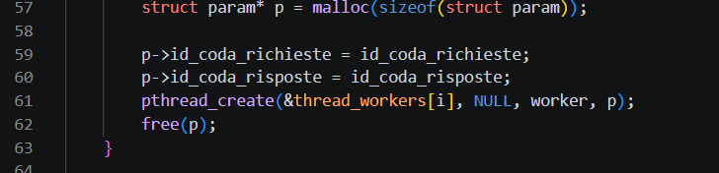
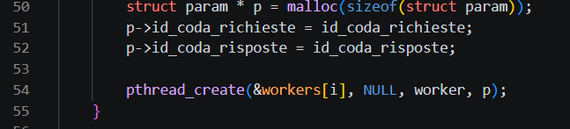
Esempio timeout
Nel FILE: server.c, nella funzione main, la chiamata pthread_create alla riga 61 libera erroneamente il puntatore struct param p immediatamente dopo la creazione del thread. Questo causa un errore di uso-dopo-liberazione quando il thread worker accede ai dati di struct param in worker alla riga 80. Questo difetto porta a comportamenti indefiniti, potenzialmente corrompendo gli ID delle code passati ai thread worker. Questo spiega gli errori di runtime osservati, inclusi "Errore msgsnd: Invalid argument" e tipi di richiesta non riconosciuti, poiché i thread worker possono ricevere parametri non validi o corrotti. Il free(p) prematuro viola l'invariante di proprietà/durata.
Codice studente:
Codice soluzione:

Slide 7
Esempio di risultato (dynamic_failure):
student | exercise | commit_analyzed | failurte_category | compile_success | test_success | stdout | stderr | test_feedback | program_output | static_warnings | llm_output_correct | llm_output_diagnosis | llm_code_correct | llm_code_diagnosis | judge_output_correct + judge_Output_Motivation | judge_code_correct + judge_Code_Motivation
chia-me | remote_procedure_call | 262d99f3d29992606d89b32c0edd36d04185d0c2 | dynamic_failure | true | false | fail |  | Esercizio remote procedure call. L'esercizio non è ancora stato svolto correttamente.L'esecuzione non è corretta: Errore nel valore di PRODUCI CON SOMMA ricevuto dal server. Il numero totale di messaggi non corrisponde a quello richiesto dalla traccia | [Produttore] Chiamo PRODUCI CON SOMMA(4, 8, 8)\n[Client] Invio richiesta PRODUCI_CON_SOMMA(4, 8, 8) (CONTINUA)… |  | NO | The client-visible responses for CONSUMA operations are incorrect. The first CONSUMA request receives a result of 9 with an error of 9, which contradicts the worker log showing a result of 9 and an error of 0. Similarly, the second and third CONSUMA requests receive results of 5 with errors of 5, while the worker logs show results of 5 with errors of 0. This mismatch in error values violates the request/reply protocol coherence. | NO | In FILE: prodcons_client.c, function consuma, the error field is incorrectly assigned the value of aconsuma.risultato at line 109. This causes the client to misinterpret the worker's response, as seen in the runtime output where the error field matches the result field instead of being 0. This violates the request/reply protocol coherence, where the error field should reflect actual errors (if any) and not the result value. The correct assignment should be errore = aconsuma.errore. | YES, The diagnosis identifies a mismatch in error values for CONSUMA operations, which aligns with the ground truth's statement about incorrect execution and errors in the PRODUCI CON SOMMA values. Both point to protocol coherence issues in the output, making the diagnosis a valid enrichment of the generic ground truth failure. | YES, The diagnosis correctly identifies the concrete issue in the diff: the student assigns aconsuma.risultato to the errore variable at line 109, instead of using aconsuma.errore as in the solution. This matches the observed failure and the protocol violation described.

Slide 8
Esempio dynamic_failure (2)
In FILE: prodcons_client.c, funzione consuma, il campo errore è assegnato in modo errato al valore di aconsuma.risultato alla linea 109. Questo causa il client a interpretare erroneamente la risposta del worker, come si vede nell'output runtime dove il campo errore corrisponde al campo risultato invece di essere 0. Ciò viola la coerenza del protocollo richiesta/risposta, dove il campo errore dovrebbe riflettere eventuali errori reali (se presenti) e non il valore del risultato. L'assegnazione corretta dovrebbe essere errore = aconsuma.errore.
Codice studente:
Codice soluzione:

Slide 9
Esempio di risultato (static_failure):
student | exercise | commit_analyzed | failurte_category | compile_success | test_success | stdout | stderr | test_feedback | program_output | static_warnings | llm_output_correct | llm_output_diagnosis | llm_code_correct | llm_code_diagnosis | judge_output_correct + judge_Output_Motivation | judge_code_correct + judge_Code_Motivation
amezak1 | un_primo_esempio_di_server_multithread | eb3316a2bd3d9354d2aecd8e4c45d9aeb57f3f4d | static_failure | true | false | fail |  | Esercizio primo esempio di server multithreadL'esercizio non è ancora stato svolto correttamente. Anche se il programma esegue, sono stati riscontrati i seguenti difetti all'interno del codice (Server.c) | Richiesta 0 Inviata (62, 17) [PID=2230209]\n\nRisposta 0 Ricevuta (1054) [PID=2230209]\n\nRichiesta 1 Inviata (26, 67) [PID=2230209](CONTINUA)… | { "file": "Server.c", "line": 41, "message": "\u00c8 richiesto che il mutex sia definito e inizializzato fuori dal ciclo while(1){...} del server. Si suggerisce di dichiarare una variabile globale di tipo pthread_mutex_t, e di inizializzarla subito prima del ciclo tramite pthread_mutex_init()." } | YES | No concrete output mismatch is visible. The trace shows consistent request/reply pairing for all clients, with correct arithmetic results for the product of the two integers in each request. The counts of requests and replies match the expected protocol (5 requests and replies per client, 3 clients total). The server termination phase is not explicitly shown but does not affect the correctness of the visible interactions. | NO | FILE: server.c, function Prodotto, lines 86-101: The mutex pthread_mutex_t mutex is initialized inside the worker thread function Prodotto at line 86. This violates the synchronization policy because the mutex is re-initialized for each thread instead of being initialized once globally. This results in each thread using a separate mutex, which fails to enforce mutual exclusion on the shared resource id_coda_risposte during msgsnd(...) at line 94. The mutex should be initialized once globally in the main server function to ensure proper synchronization across all threads. | YES, The diagnosis correctly states that no concrete output mismatch is visible and aligns with the ground truth, which confirms the visible execution/output is correct. It does not invent any additional problems or contradict the ground truth. | YES, The diagnosis correctly identifies the same underlying defect mechanism as the ground truth warning: the improper initialization of the mutex within the worker thread function instead of globally, which violates synchronization requirements. The diagnosis provides additional details about the consequences (failure to enforce mutual exclusion) but remains within the same defect family and does not contradict the ground truth.

Slide 10
Esempio di risultato (static_failure):
student | exercise | commit_analyzed | failurte_category | compile_success | test_success | stdout | stderr | test_feedback | program_output | static_warnings | llm_output_correct | llm_output_diagnosis | llm_code_correct | llm_code_diagnosis | judge_output_correct + judge_Output_Motivation | judge_code_correct + judge_Code_Motivation
CryptoGionni | server_aggregatore_thread | 08557ac8ccee96209b8600dc2cd9b62681c0fd8b | static_failure | true | false | fail |  | Esercizio server aggregatore con thread L'esercizio non è ancora stato svolto correttamente. Anche se il programma esegue, sono stati riscontrati i seguenti difetti all'interno del codice (aggregatore.c) | Avvio processo collettore (id coda = 6619185)...\nCollettore: In attesa di messaggi...(CONTINUA)… | { "file": "aggregatore.c", "line": 226, "message": «E’ necessario che i lettori possano leggere contemporaneamente il dato condiviso. Si applichi qui l'algoritmo visto a lezione." } | NO | The output shows mismatched values between the sensor and collectors. The sensor generates 10 values, but the collectors receive inconsistent sequences. For example, the sensor sends \"8, 3, 2, 7, 1, 0, 2, 3, 2, 8, \" but collectors receive different sequences, with some values duplicated or missing. This indicates a failure in the forwarding or distribution phase. Additionally, the counts of received values per collector are inconsistent with the expected 10 messages per collector. The visible protocol does not ensure correct pairing, ordering, or completion of the producer/consumer interaction. | NO | FILE: aggregatore.c, function lettura (lines 180-199): The reader-writer synchronization policy is violated. The condition variable VC_SCRITT is signaled (line 197) even when there are active readers (num_lett > 0). This can lead to a writer proceeding while readers are still accessing the shared variable, breaking the reader-writer concurrency requirement. The signal should only occur when no readers are active. | NO, The ground truth states that the visible execution/output is correct, but the diagnosis claims mismatched values, inconsistent sequences, and protocol failures, which contradicts the ground truth. The diagnosis invents problems not present in the output per the ground truth. | YES, The diagnosis identifies a reader-writer synchronization policy violation, which is causally related to the ground truth warning about ensuring readers can read concurrently. Both address the same defect mechanism of improper synchronization in the reader-writer concurrency model.

Slide 11
Esempio di risultato (correct):
student | exercise | commit_analyzed | failurte_category | compile_success | test_success | stdout | stderr | test_feedback | program_output | static_warnings | llm_output_correct | llm_output_diagnosis | llm_code_correct | llm_code_diagnosis | judge_output_correct + judge_Output_Motivation | judge_code_correct + judge_Code_Motivation
ManuelParasmo | un_primo_esempio_di_server_multithread | 006ef42d9d586537e5d1b18d4b5c3c411be92b73 | correct | true | true | pass |  | Esercizio primo esempio di server multithreadCongratulazioni, l'esercizio compila ed esegue correttamente, e non è stato riscontrato nessuno degli errori frequenti nel codice | Richiesta 0 Inviata (36, 32) [PID=2361413]\n\nRisposta 0 Ricevuta (1152) [PID=2361413]\n\nRichiesta 1 Inviata (11, 54) [PID=2361413](CONTINUA)… |  | YES | No concrete output mismatch is visible. The trace shows consistent request/reply interactions for all three clients, with each client sending 5 requests and receiving 5 replies. The computed product values in the replies match the input values in the corresponding requests, and the counts, pairing, and ordering are coherent with the exercise description. | YES | No concrete correctness concrete defect is visible from the provided code and runtime context. The execution output matches the expected behavior described in the exercise, with correct message exchanges and computations. Mutex usage ensures mutual exclusion for the response queue, and all threads handle their tasks correctly." | YES, The diagnosis correctly states that no concrete output mismatch is visible and aligns with the ground truth, which confirms the output is correct. It does not invent any additional problems or contradict the ground truth. | YES, The diagnosis correctly states that no concrete correctness defect is visible, and the observed feedback confirms the code compiles and executes correctly. The diff shows only superficial differences (e.g., variable names, formatting) that do not constitute correctness violations. The diagnosis aligns with the rules and observed feedback.

Slide 12
Statistiche esercitazione 5
Numero di studenti con almeno 1 commit: 110
Numero totale di commit git: 1044
Numero totale di modifiche agli esercizi: 877
Numero di modifiche analizzate tramite LLM: 330

Slide 13
Statistiche per esercizio
Tabella categorie di fallimento per esercizio:
exercise | compile_failure | crash | timeout | ipc_leak | dynamic_failure | static_failure | correct
remote_procedure_call | 105 | 0 | 40 | 3 | 123 | 0 | 0
server_aggregatore_thread | 7 | 0 | 23 | 1 | 162 | 2 | 49
un_primo_esempio_di_server_multithread | 105 | 0 | 36 | 2 | 45 | 41 | 133

Slide 14
Analisi effettuate mediante LLM, esercitazione 5
Su un totale di 330 esercizi sono state condotte le seguenti analisi:
Distribuzione per failure category.
Analisi dynamic_failure:
Analisi Output LLM
Analisi Codice LLM
Analisi static_failure:
Analisi Output LLM
Analisi Codice LLM
Analisi corretti:
Analisi Output LLM
Analisi Codice LLM

Slide 15
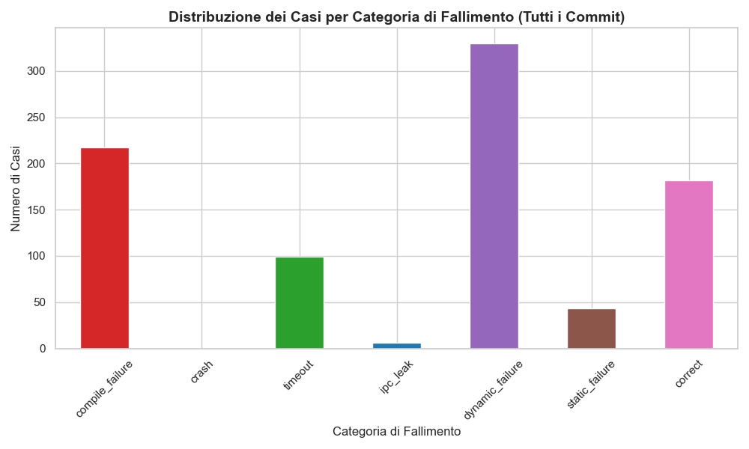
Distribuzione per failure category (tutti i commit, analizzando solo modifiche)

Slide 16
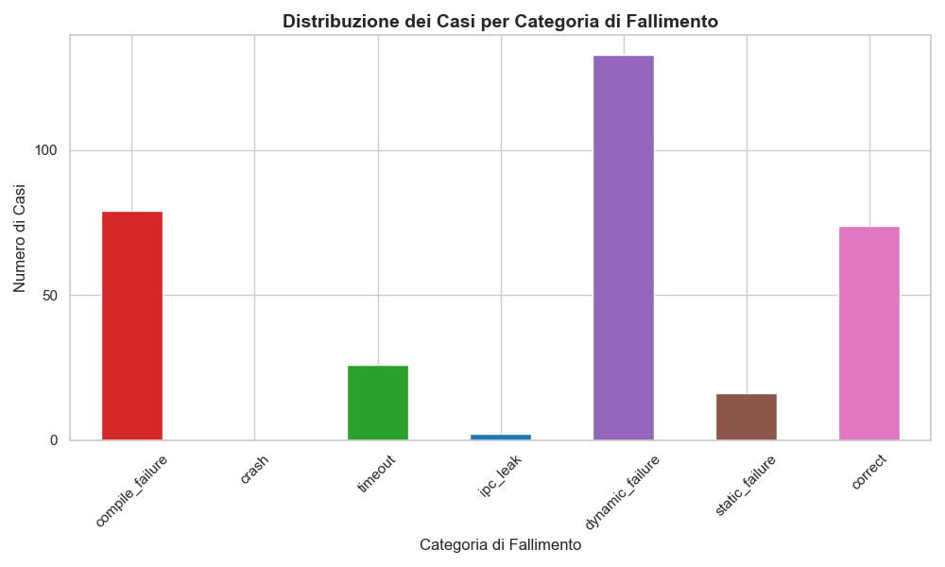
Distribuzione per failure category

Slide 17

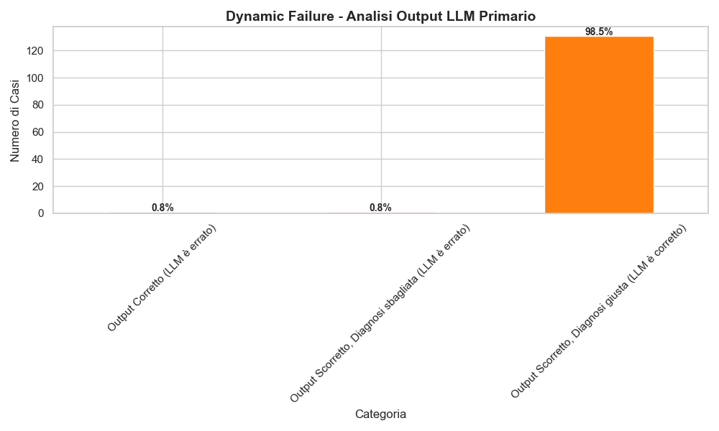
Dynamic Failure - Analisi Output LLM Primario
% LLM primario dice che output è corretto (non trova l'errore).
% LLM primario dice che è scorretto, ma diagnosi output non è corretta.
% LLM primario dice che è scorretto, e la diagnosi output è corretta.

Slide 18
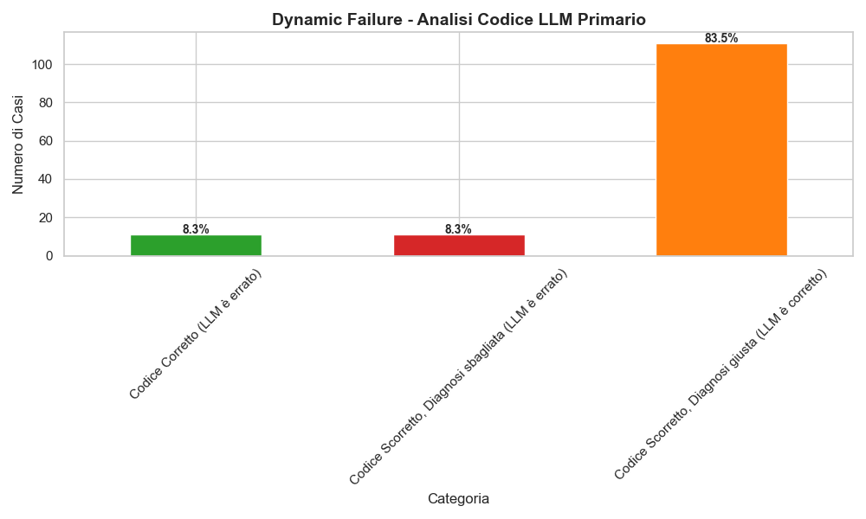
Dynamic Failure - Analisi Codice LLM Primario
% LLM primario dice di non aver trovato l'errore nel codice.
% LLM primario dice che è scorretto, ma diagnosi codice non è corretta.
% LLM primario dice che è scorretto, e la diagnosi codice è corretta.

Slide 19
Possibili cause errori LLM(dynamic failure)
Esempio comune: al3ssandr0rabb0ni, esercizio remote_procedure_call, commit 0a4946a00cc75cae2debdbae9af82eed1c221a95
Diagnosi codice LLM(YES, correct): No concrete correctness concrete defect is visible from the provided code and runtime context. The communication between the client and server via message queues appears coherent, with proper message types and payloads being sent and received. The worker threads process requests correctly, and synchronization for shared resources is implemented using mutexes and condition variables. The observed runtime output matches the expected behavior described in the exercise.
Diagnosi giudice codice(NO): The diagnosis claims no concrete correctness defect is visible, but the observed feedback explicitly mentions incorrect execution due to an error in the value of \"PRODUCI CON SOMMA\" and a mismatch in the total number of messages. The diff shows structural differences in message queue permissions, msgctl calls, and message handling logic, which could plausibly cause the observed issues. The diagnosis fails to address these differences and their potential impact on correctness, making it incomplete and inaccurate.
Il modello si aspetta che PRODUCI e PRODUCI_CON_SOMMA restituiscano subito il risultato finale, e per questo segnala un errore quando vede 0. In realtà, il risultato corretto viene calcolato e restituito solo più tardi da CONSUMA.
Nella diagnosi del codice, il modello si basa su questa ipotesi plausibile invece di seguire il flusso reale: di conseguenza spesso manca il vero bug o segnala problemi irrilevanti.

Slide 20
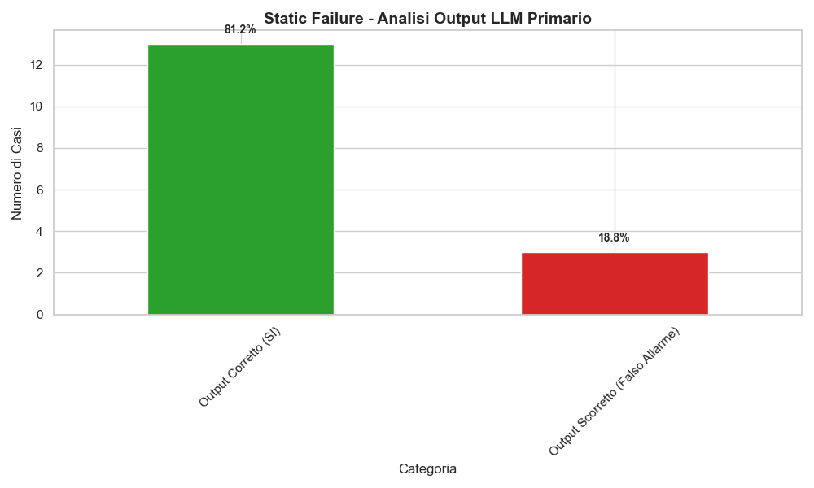
Static Failure - Analisi Output LLM Primario
% LLM primario dice che output è corretto (è ok, si trova con ground truth).
% LLM primario dice che è scorretto (diagnosi è scorretta a prescindere).

Slide 21
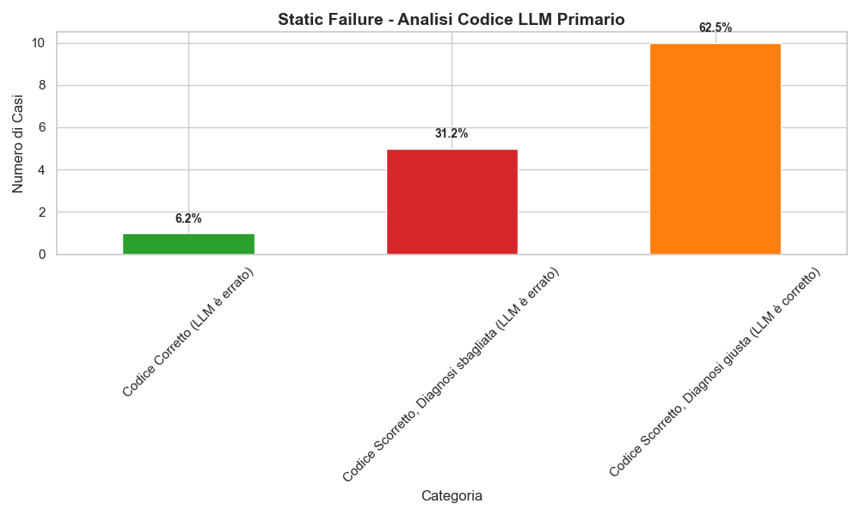
Static Failure - Analisi Codice LLM Primario
% LLM primario dice di non aver trovato l'errore nel codice.
% LLM primario dice che è scorretto, ma diagnosi codice non è corretta.
% LLM primario dice che è scorretto, e la diagnosi codice è corretta.

Slide 22
Possibili cause errori LLM(static failure)
Esempio comune: Beccio-san, esercizio un_primo_esempio_di_server_multithread, commit 1cb94a559ec7a9afd6a4290fba9db5cafe601f3f
Warning: Per il passaggio di parametri dal thread principale ai thread worker, è necessario definire una struttura dati per contenere i valori dei parametri; poi, ogni volta che viene creato un thread worker (ossia all'interno del ciclo while), occorre allocare sullo heap una istanza della struttura, e passarla al thread worker tramite pthread_create().
Diagnosi codice: FILE: server.c, function server, lines 71-73: The thread worker is created using pthread_create, passing a dynamically allocated msg_richiesta structure. However, the thread attribute pthread_attr_t attr is initialized but not explicitly destroyed using pthread_attr_destroy. This violates proper lifetime management of thread attributes, potentially leading to resource leaks.
Giudice codice (NO): The diagnosis focuses on the lifetime management of pthread_attr_t attr, which is unrelated to the ground truth warning about parameter passing and heap allocation for thread workers. These are distinct defect families
L'errore più comune è sbagliare la tipologia di difetto.
La ground truth si riferisce al passaggio parametri ai worker tramite struttura allocata su heap, mentre LLM diagnostica la mancata pthread_attr_destroy, che il giudice boccia come "different defect family".
In questa categoria c’è anche un secondo pattern: talvolta il modello inventa problemi di output anche se il feedback dice che l'esecuzione è corretta e il problema è solo statico.

Slide 23
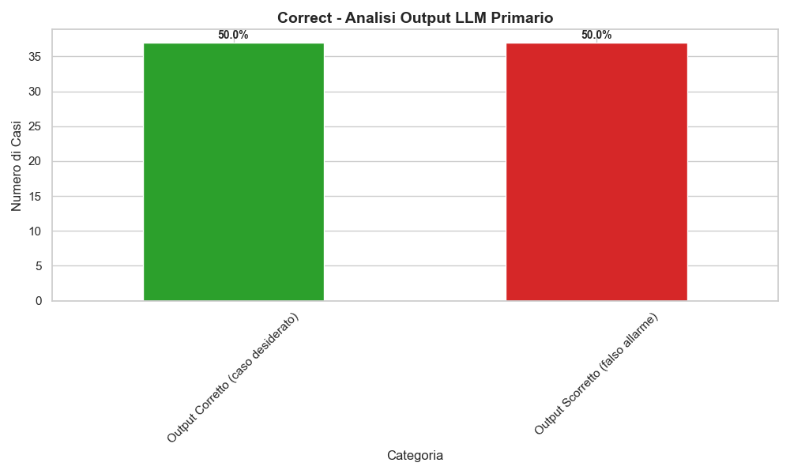
Corretti- Analisi Output LLM Primario (falsi positivi)
% LLM primario dice che output è corretto (è ok, si trova con ground truth).
% LLM primario dice che è scorretto (diagnosi è scorretta a prescindere).

Slide 24
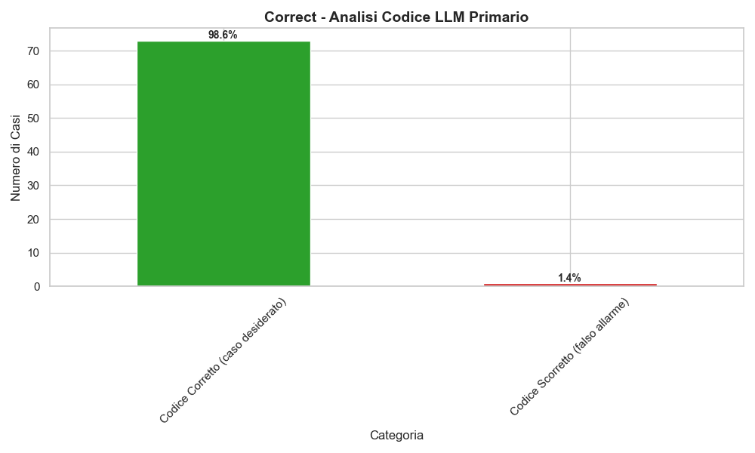
Corretti- Analisi Codice LLM Primario (falsi positivi)
% LLM primario dice che codice è corretto (è ok, si trova con ground truth).
% LLM primario dice che è scorretto (diagnosi è scorretta a prescindere).

Slide 25
Possibili cause errori LLM(correct)
Esempio comune: andreatrimarchi, esercizio server_aggregatore_thread, commit 4c1099ac4159060a2ae6d1f65b289aeaa8478c58
Diagnosi output: The output shows mismatched counts between the sensor's 10 generated values and the collectors' received values. Each collector should receive all 10 values, but one collector receives only 9 values. Additionally, the aggregatore's forwarding behavior shows inconsistent counts and interleaving issues, with some values being read or sent multiple times while others are missing. This indicates protocol violations in value propagation, pairing, and completion.
Il modello in alcuni casi conta male i messaggi o vede duplicazioni/perdite che la ground truth non vede

